Slide 1
Cromarty Youth Café Report for Community Council May 2023

Slide 2
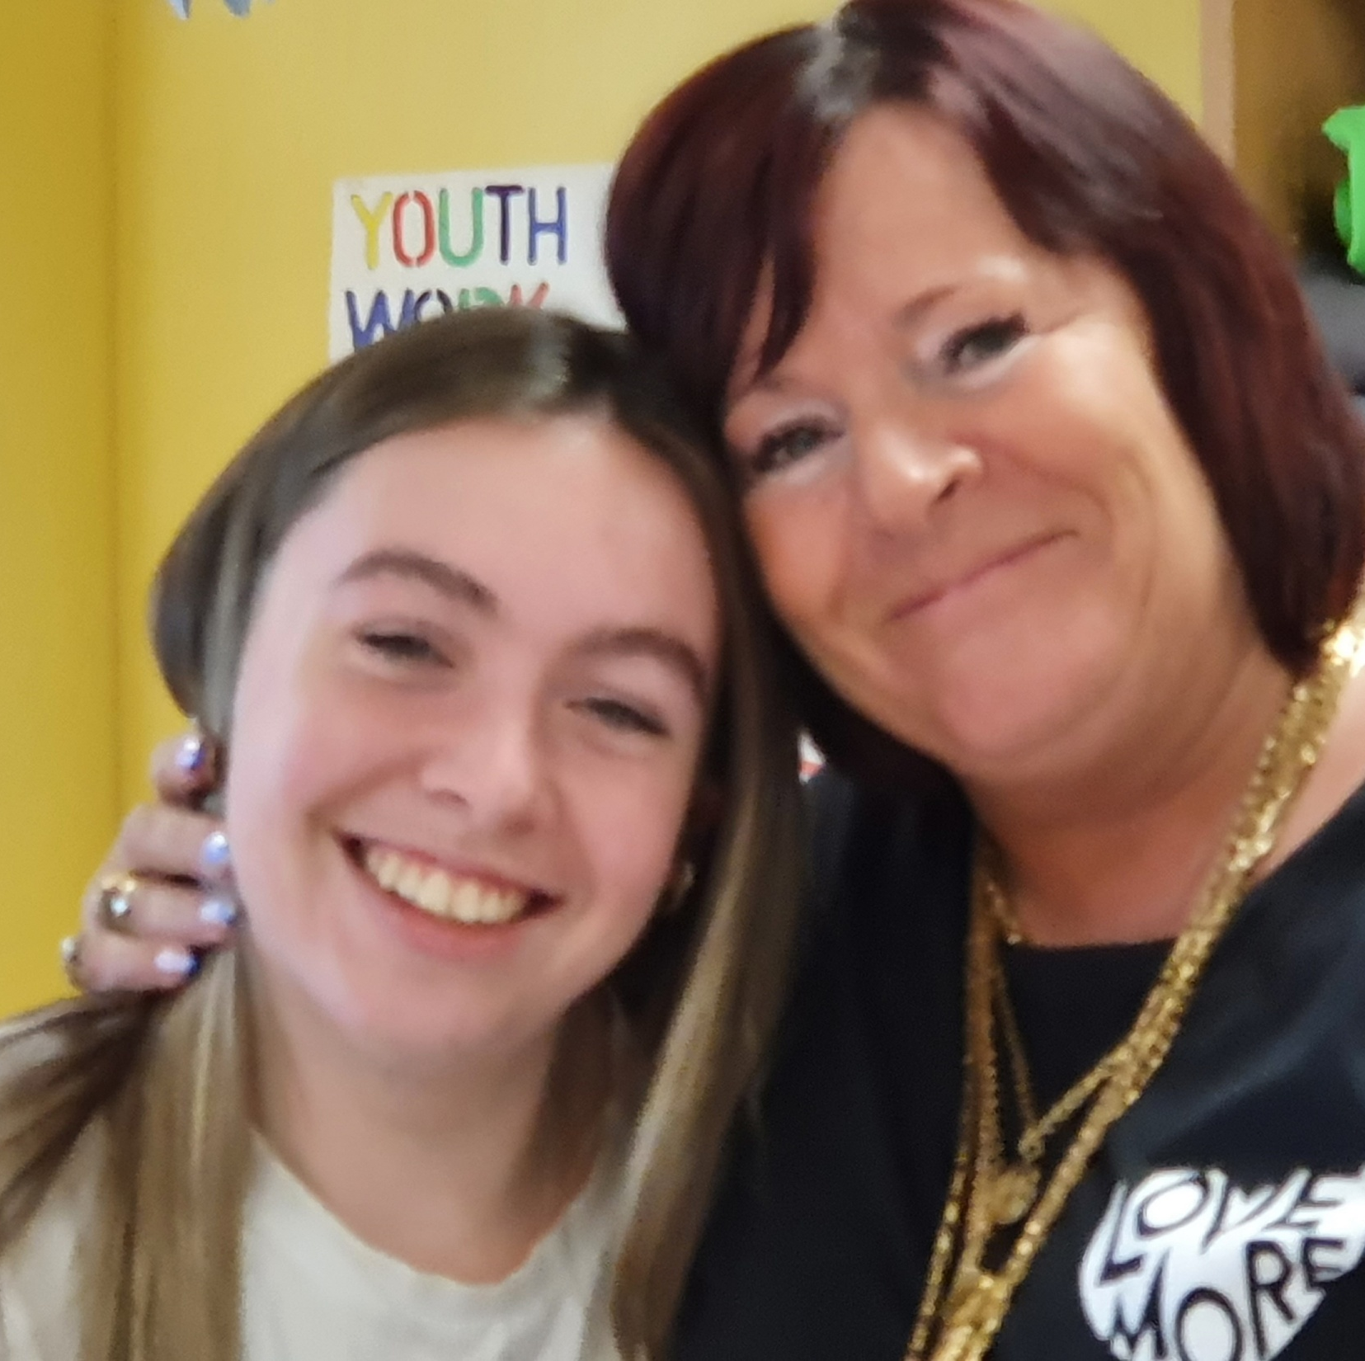
Returning Young People
On this Well-being Wednesday we have a VERY HAPPY Wanda Surprised and Delighted with a Secret visit
Flown all the way back from her 6 months in Australia Last Night and came straight into the Youthwork Classroom to see us.
#lifelongfriends
#youthworkchangeslives
#smilesforfree

Slide 3
Stats for this Month
Number of:
Young People worked with 357
Learning Hours: 496
Programmed activities: 35
500+ people at the Coronation Event in Cromarty

Slide 4
Football Training with ICT Youth Development
We have been working with ICT Youth Development for the last 2 years
Young people are learning about ball control, passing skills and shooting,
The improvement in the young people is amazing,
The coaches enjoy coming to Cromarty each week to deliver football coaching.
The ICT football coaches have been skilling up our young leaders teaching them new skills and games

Slide 5
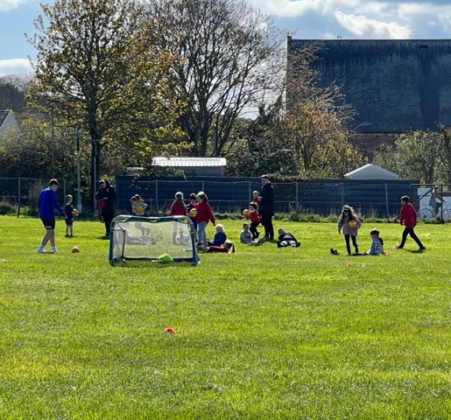
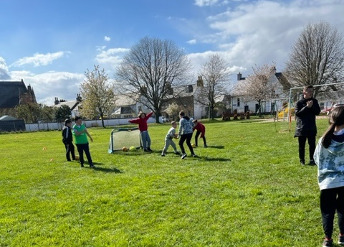
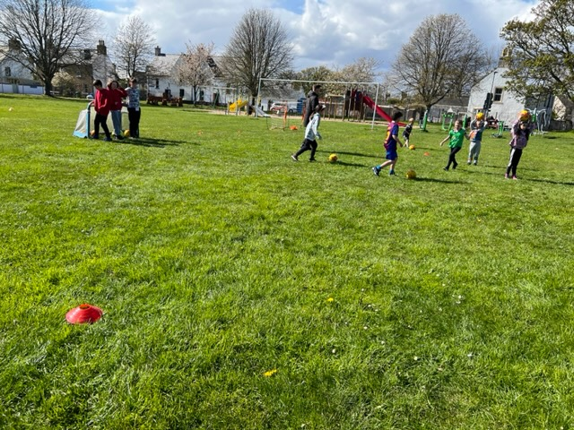

Slide 6
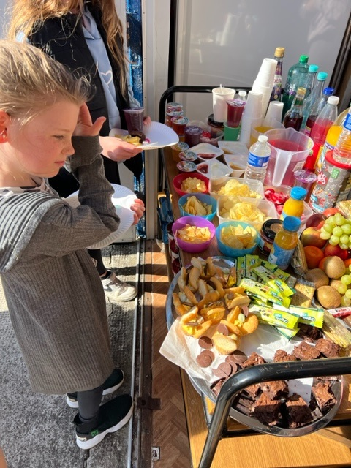
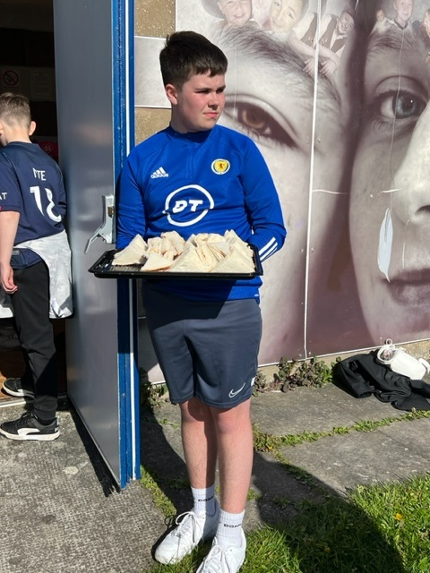
The Food

Slide 7
Show & Row Sessions
Weekly sessions,
Planning with young people looking at the rowing timetable and working out when the boat was available so they could get extra slots outwith there usual slot to be able to practise as a team
The enjoyment the young people get out of being on the water is incredible.
Young people are practising their timing and form for rowing, Learning about, Wind, Weather, Tides enabling young people to be come safe at sea

Slide 8
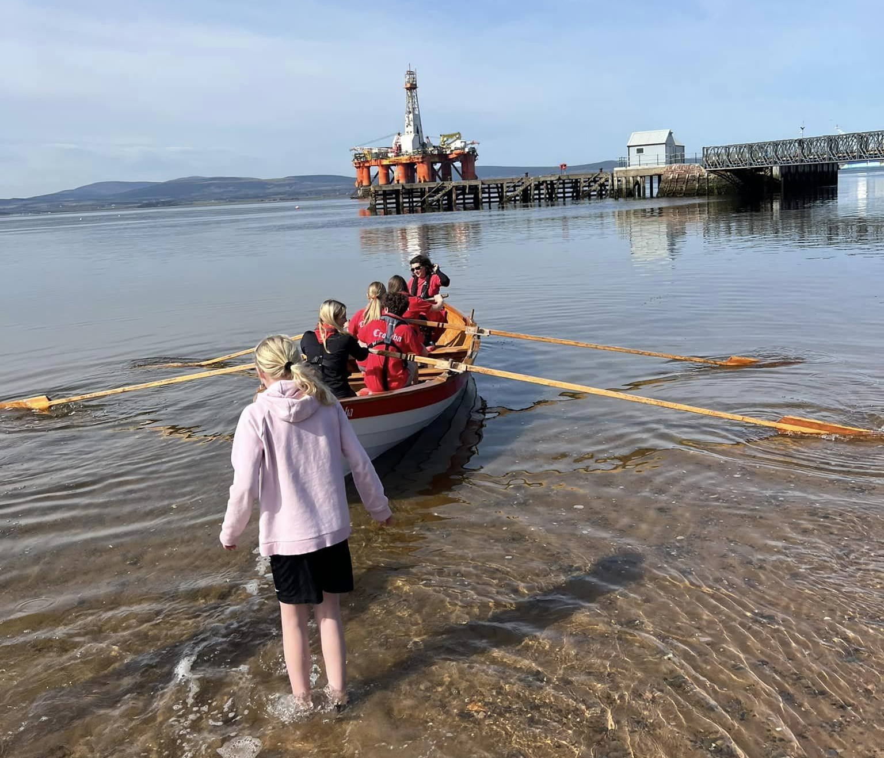
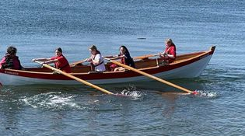
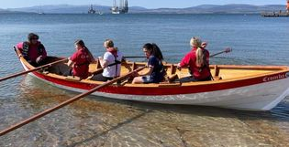
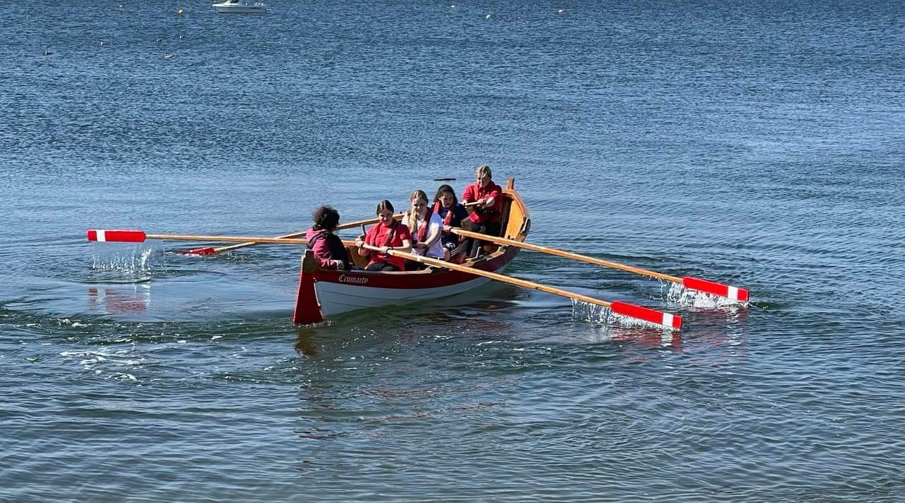

Slide 9
Multi-Sports
Delivered on a Monday by young leaders,
Young people have the opportunity to take part in a range of different sports and to try something new.
Young people have lots of fun each week.

Slide 10
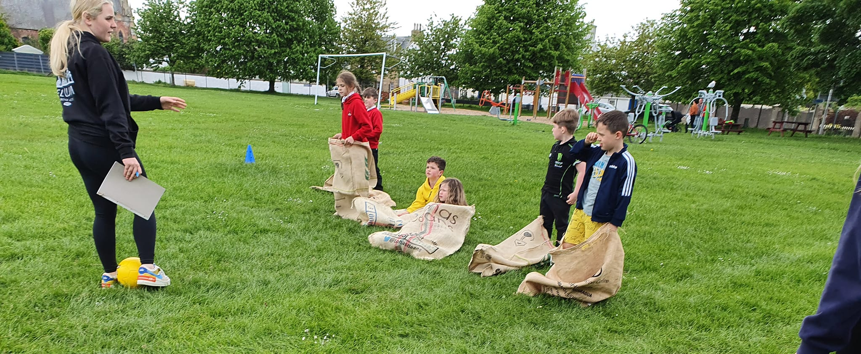
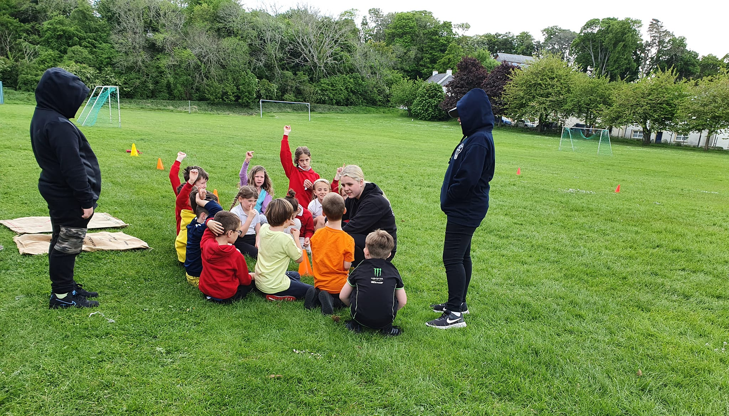
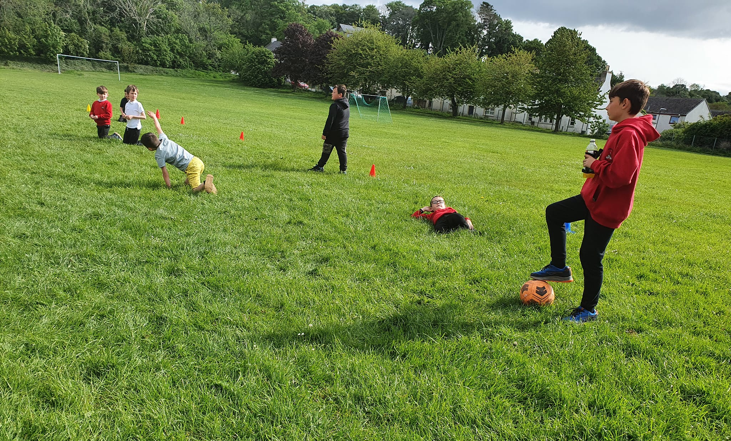

Slide 11
Jnr Youth Café
Weekly sessions with around 50 attendees weekly,
Each session is planned and delivered by Young people and supported by Wanda & myself,
Youth Consultation about what young people would like to see at the Youth Café
Themed Arts & Crafts and various different sport’s
Young people tell us they love coming to Youth Café, and they look forward to a Wednesday night.
One YP asks me when I am walking down the street in Cromarty asks every day “Is Youth Café on tonight?”

Slide 12
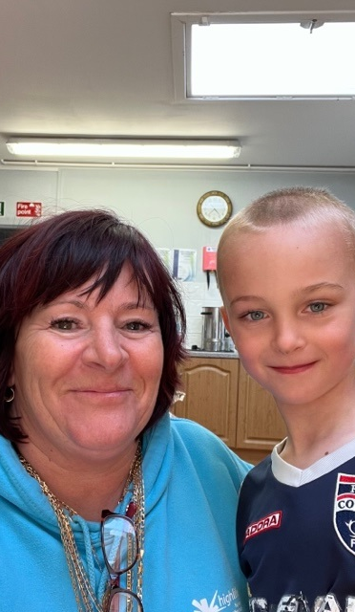
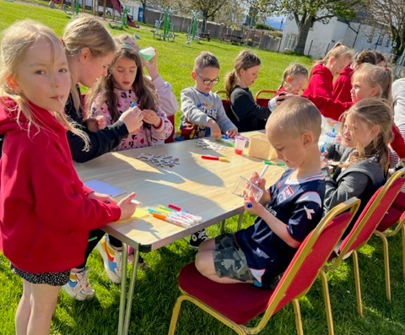
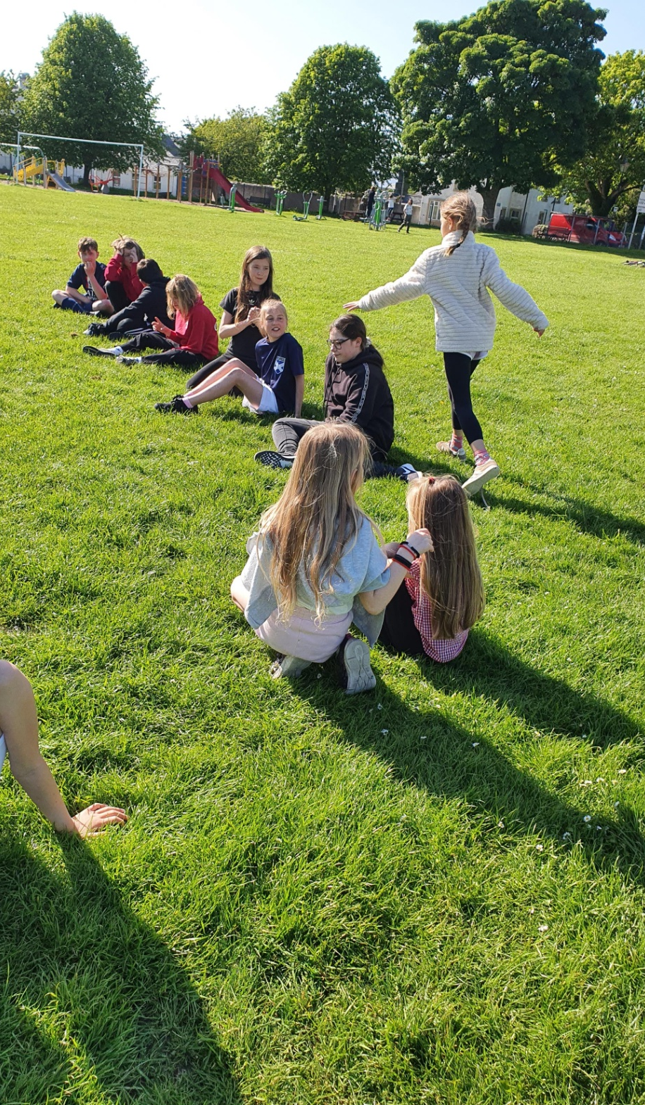
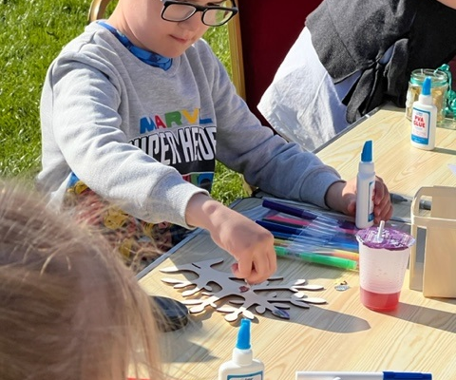

Slide 13
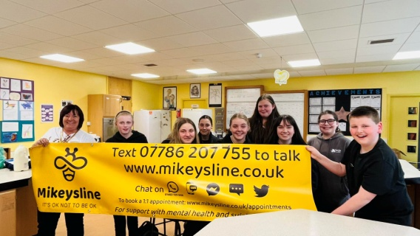
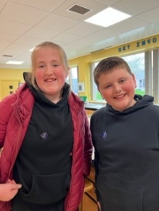
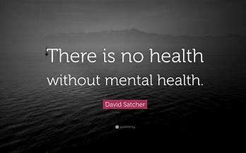
Get Heard - Mental Health Work
Continuing area of high concern on the Black Isle – access to mental health support and working with partners is key
We have 10 mental health ambassadors in Fortrose Academy from various year groups , they are looking at reducing the stigma of mental health , social media bullying , the transition from P 7 in to the big school some first years have felt this was very overwhelming ,
MikeysLine – Interactive and informative session with Allana from Mikeysline Highlighting the services Mikeysline provide both within the school setting and out with.
Young people tell us being part of our group helps them build relationships with positive role models , and that they have improved, communication skills and behaviours, better at listening to others and their needs and experiences A number of our group had had trauma and suffered sadness loss and grief they are keen there is more done to support young and older yp
Daily emotional check-in’s with YP, fears around exams, and leaving school, and now needing to step out of their comfort Zone,
Anxious about exam results
Resilient Kids moving up programme has been delivered to all P7’s across the ASG over the past year – Through a group of six friends, the programme explores various issues and helps pupils to develop skills, build confidence and become more resilient
helps young people build positive social, emotional, thinking and communication skills and behaviours.
Archie & Maisie wearing their mental health ambassador Badges with pride

Slide 14
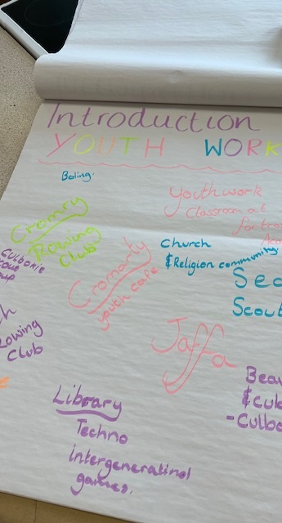
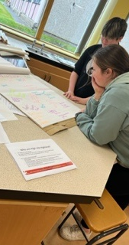
Introduction to Youthwork Training
30 young people took part in the course at over various sessions:
Focusing on:
What Is Youth Work
What is the Purpose of Youth Work
Three Essential and Definitive Features of Youth Work
Who Does Youth Work in Highland
Accountability in Youth Work
The Why, How & Where of Youth Work Youth Work Outcomes
Challenges & Barriers to Youth Work
Evaluation & Reporting in Youth Work
Youth Work Polices and Strategies
Case Studies

Slide 15
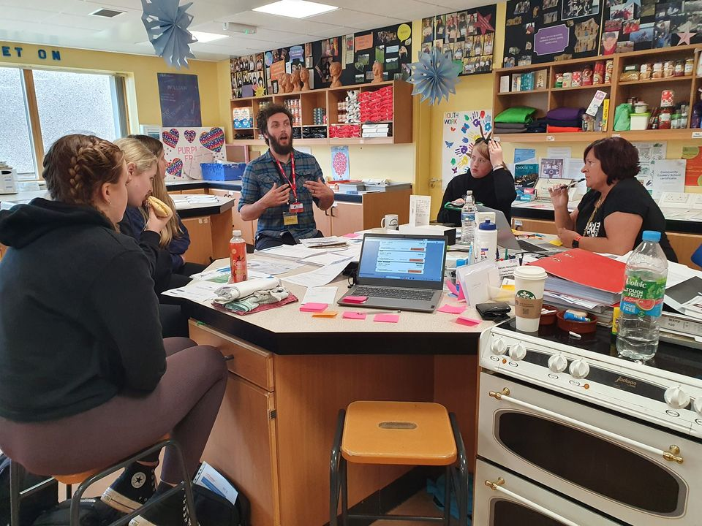
Planning Meeting with Fun Palaces
Great meeting today with Ruari from Eden Court's Fun Palaces - planning using our skills in - Arts 🎭 , Culture, Heritage , Crafts, Sports , the environment and sciences 🧫 🧬 more news in Summer Programme 2023 😎

Slide 16
Leadership & Learning
20 young people are taking part in the Highlife Highland Choose to Lead Level 4 Award (SCQF Rated Level 4)
The choose to lead award focuses on Young people planning, preparing, delivering & then evaluating the session.
These sessions will be delivered at Multi-Sports, After school clubs, Rowing & Youth Café.
Young people need to deliver 40 hours of their time to gain the award while filling in their paperwork.
This is overseen by Wanda and will then be signed off by University of Inverness (UHI)
A number of young people from Cromarty are taking part in Saltire Award & HLH Leadership Award

Slide 17
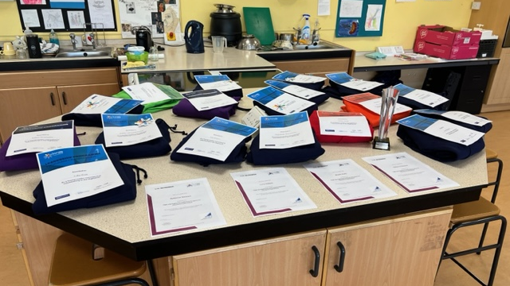

Slide 18
Funding Application
Spar Funding – we applied for funding from the Spar – this was unsuccessful
Corra Foundation - £3,000 applied for YC Running Costs & Staff Time
Wanda has met with Port Of Cromarty Firth Authority – Application submitted for £1000
MFR Cash for Kids application was successful for food during Easter & Summer Programme - £800 total
Scottish Families effected by Substance Misuse - £1000 for YC Activities
Letter written to Sir Iain Foundation – One-off Donation of £250 received
Application to Family Recovery Initiative Fund £1000 staff Costs, Venue & Refreshments

Slide 19
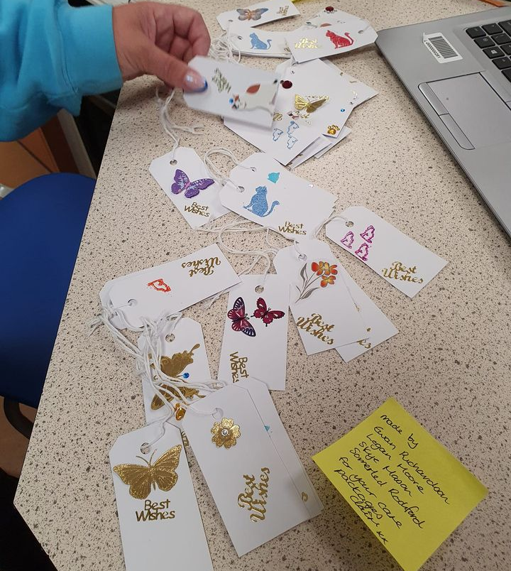
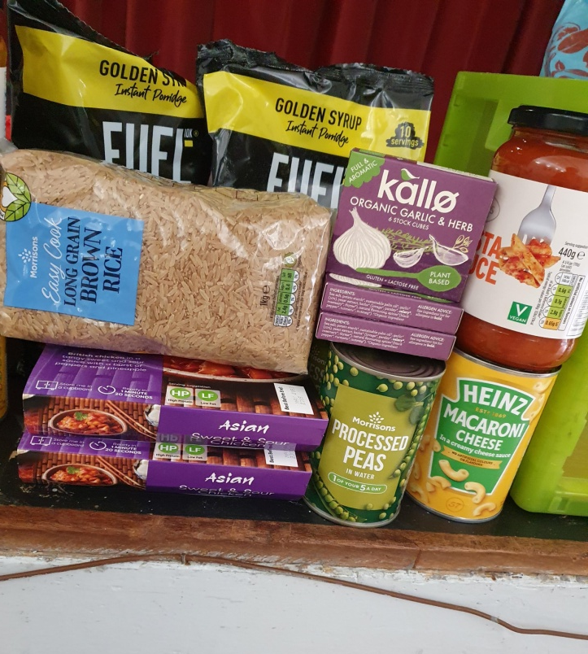
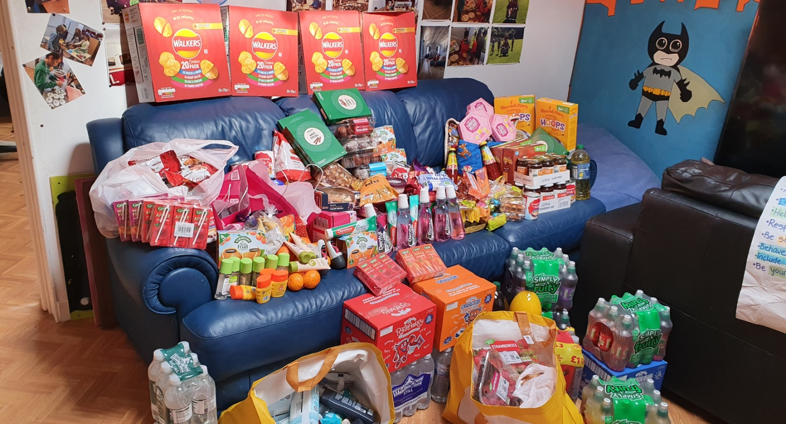
Well-being Bags
With funding from Highland Council Cost of Living Funding we purchased items to create well-being bags to be given to member of the youth café and vulnerable members of the community, these bags were complimented with Items we received from Cfine.
Each bags has a handmade tag to go with it.

Slide 20
Leading up to the Coronation Community Event
Practicing the Cromarty Song with some members of the Fourways Club
Young people getting Creative designing crowns, knights , coronation wordsearches and Mazes.
King’s Krew taking part in their Dynamic Youth Award and putting the final touches and planning their Rota – Portfolios – have now been submitted
Delighted to have some famous celebrities join us on Monday

Slide 21
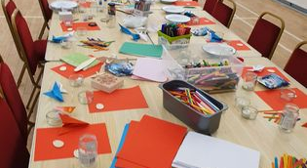
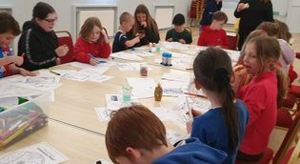
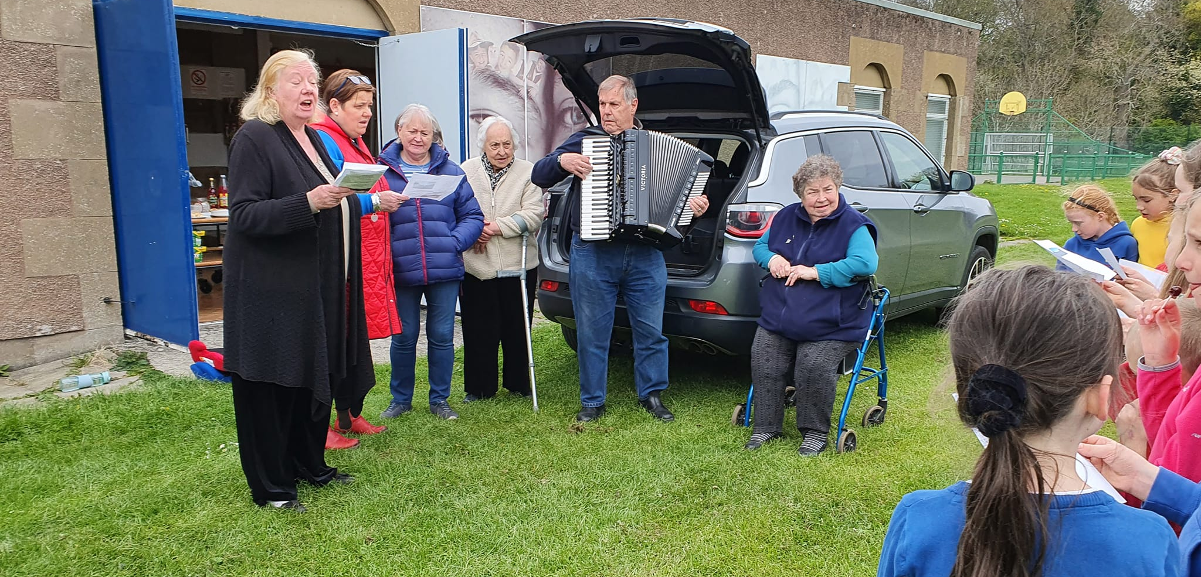
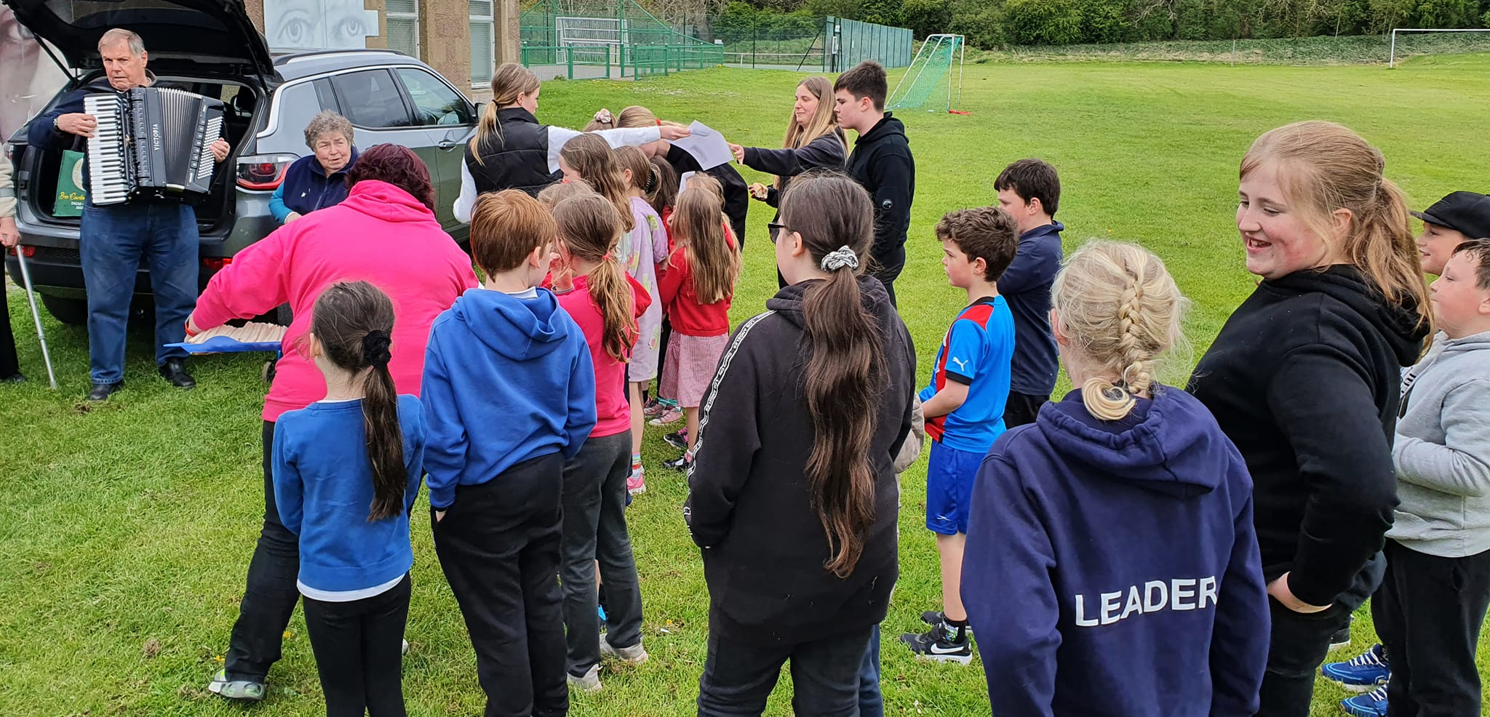

Slide 22
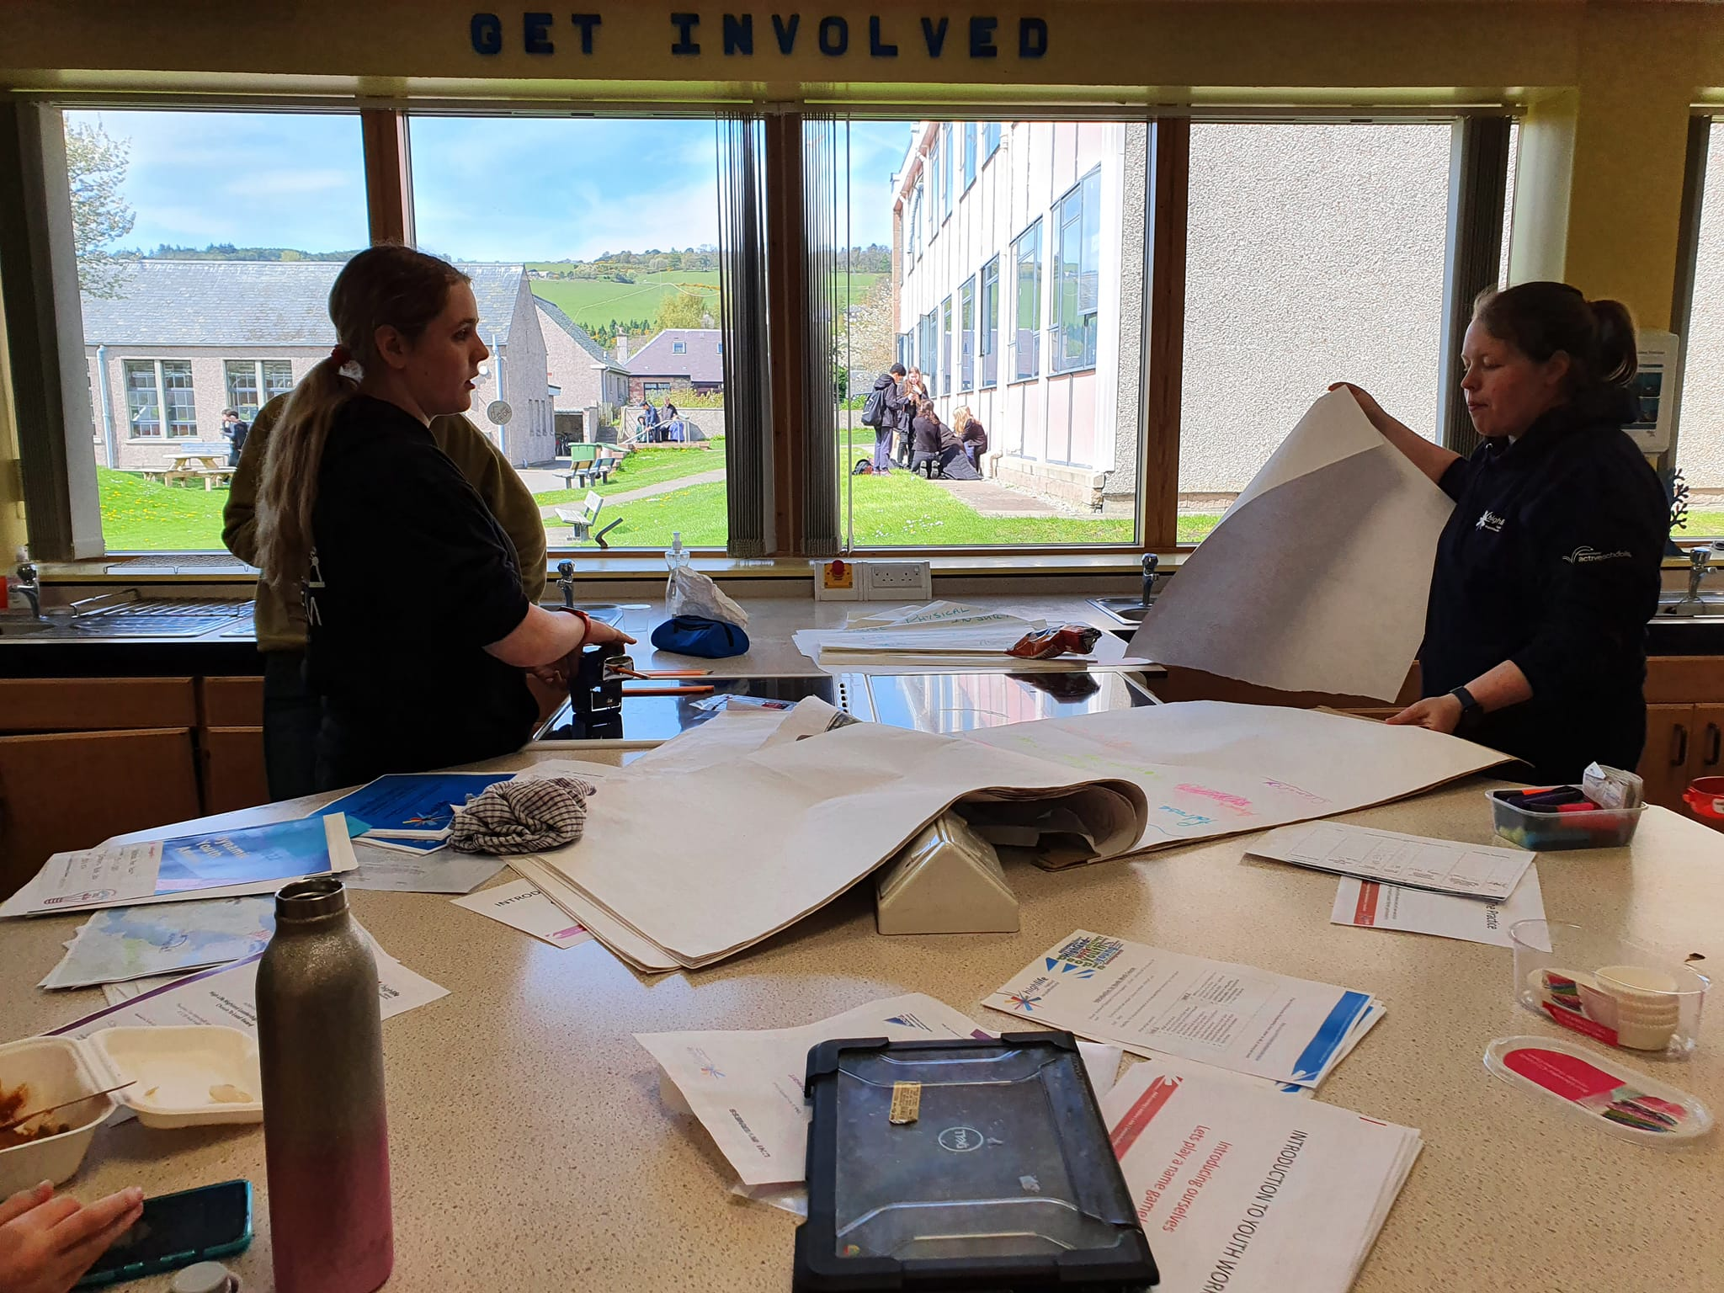
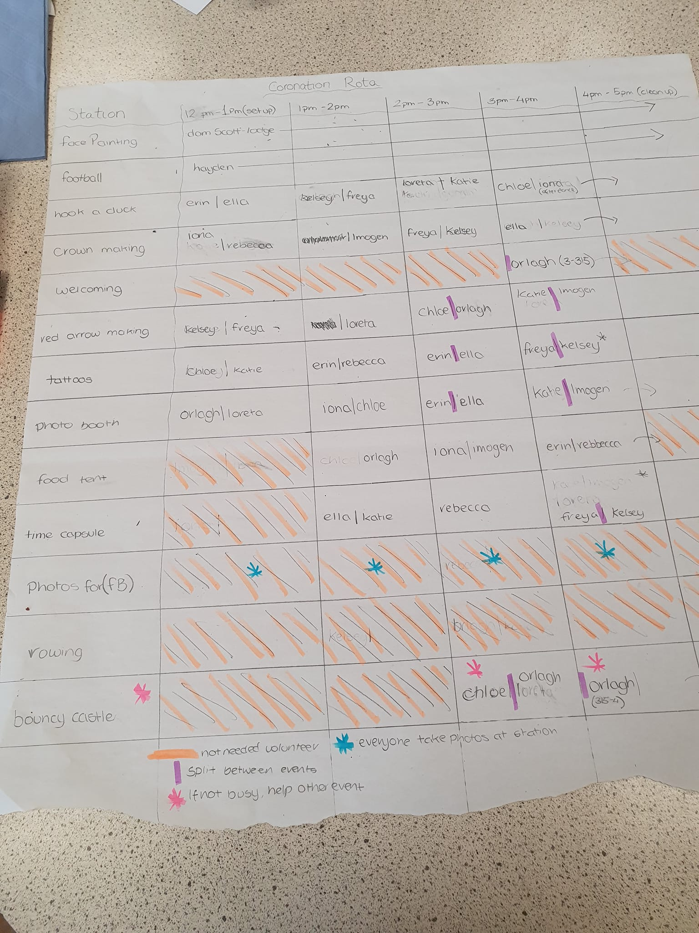

Slide 23
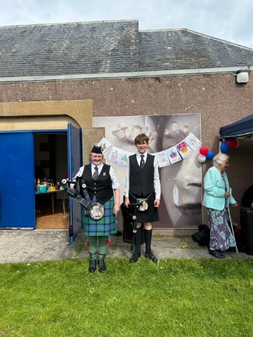
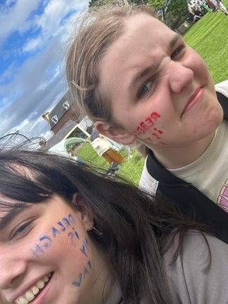
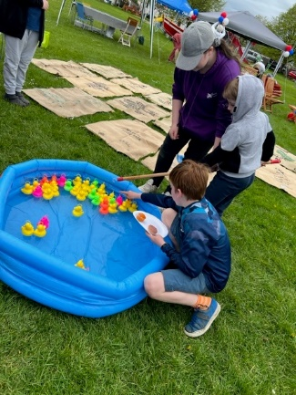
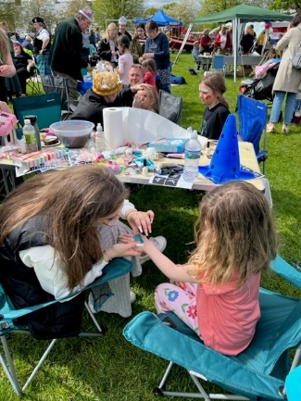
Cromarty’s Coronation Community Celebration: -
Huge thanks to our Lord Lieutenant Joanie
Alistair Fox and Flora for piping
Iona Bowne our Highland Dancer 💃 who wowed the crowds
Ramsay and Jonathon for the Amazing music
The 4 ways club for the Cromarty song singalong ❤️
Steve for his Hip Hop and Dance 🕺🏻🕺🏻🕺🏻
Rebecca for her fabulous baking
The Inspire 2022 Kings Krew for there outstanding work in planning and delivering
of all their fun and exciting activities.
Karrie and Chris from Creativity in Care for their fabulous crown making session
Our group of face painters and glitter tattoo artists for outstanding efforts
Inverness Caley Thistle for the football session
Our fabulous catering crew Michelle Joanna & Ethan
Vicky for her Tennis 🎾
#bringingthecommunitytogether
#kingscoronation2023
#KingsCrew
Partners at the Event:
Cromarty Youth Café
Cromarty 4ways Club
Cromarty Tennis & Sports Club
Cromarty Community Rowing Club
Cromarty History Society
RNLI

Slide 24
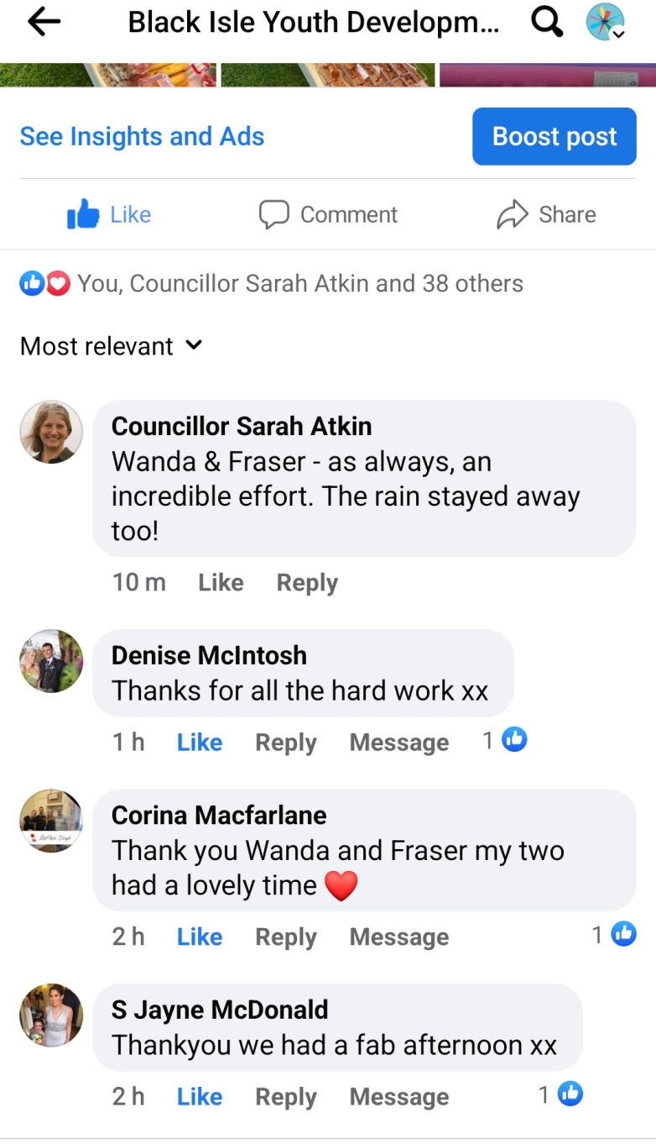
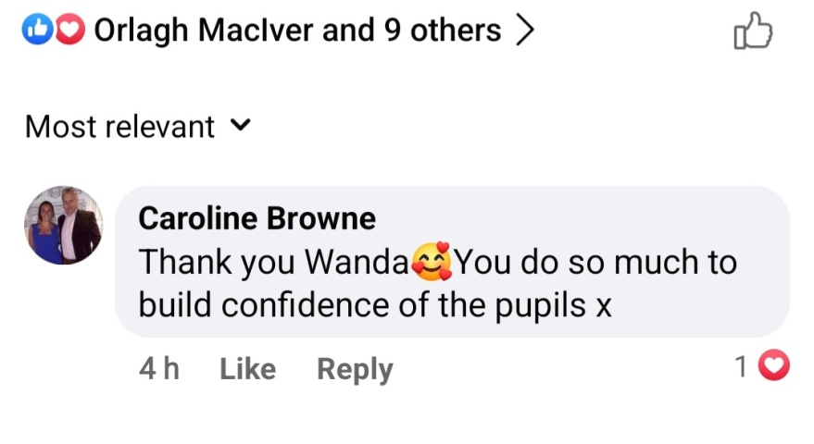
Feedback
Feedback about Cromarty’s Coronation Community Celebration
Voicemail from Anne Short OBE – telling me how the young people at the Kings Coronation Event are a credit to me, and how proud she was of them

Slide 25
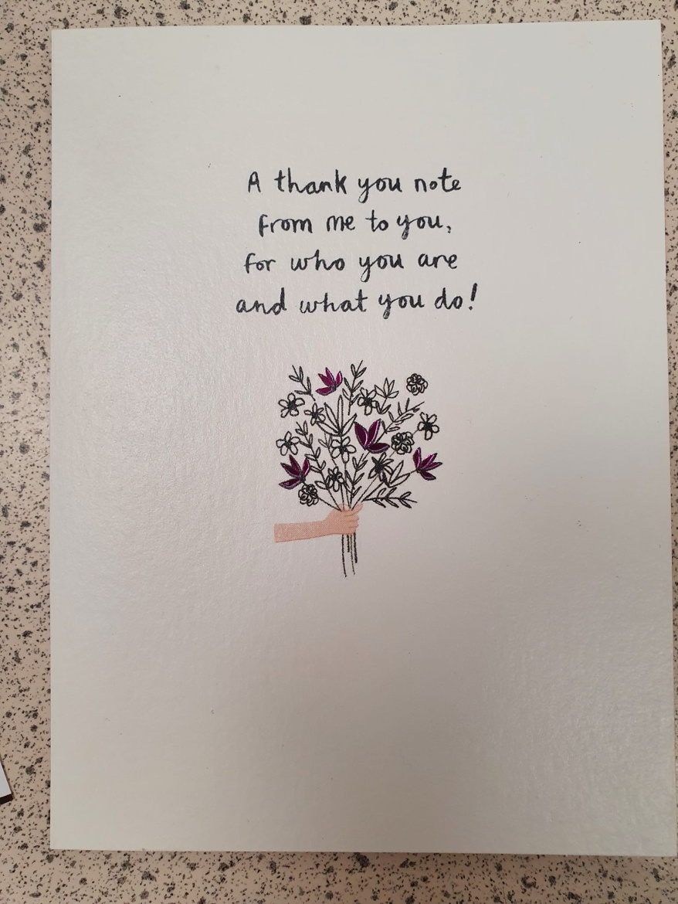
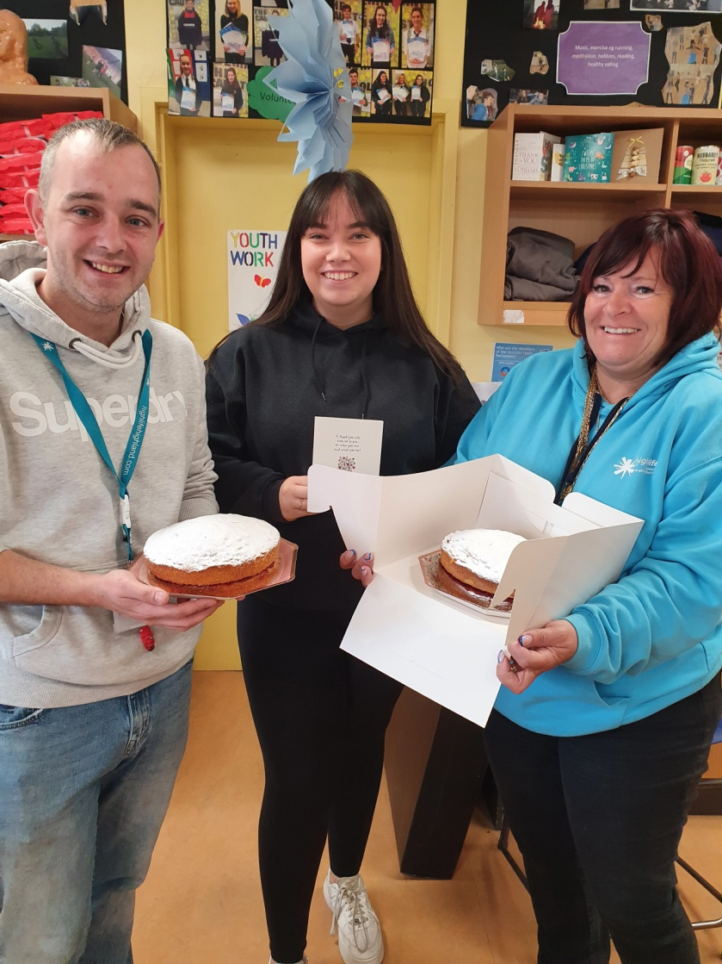
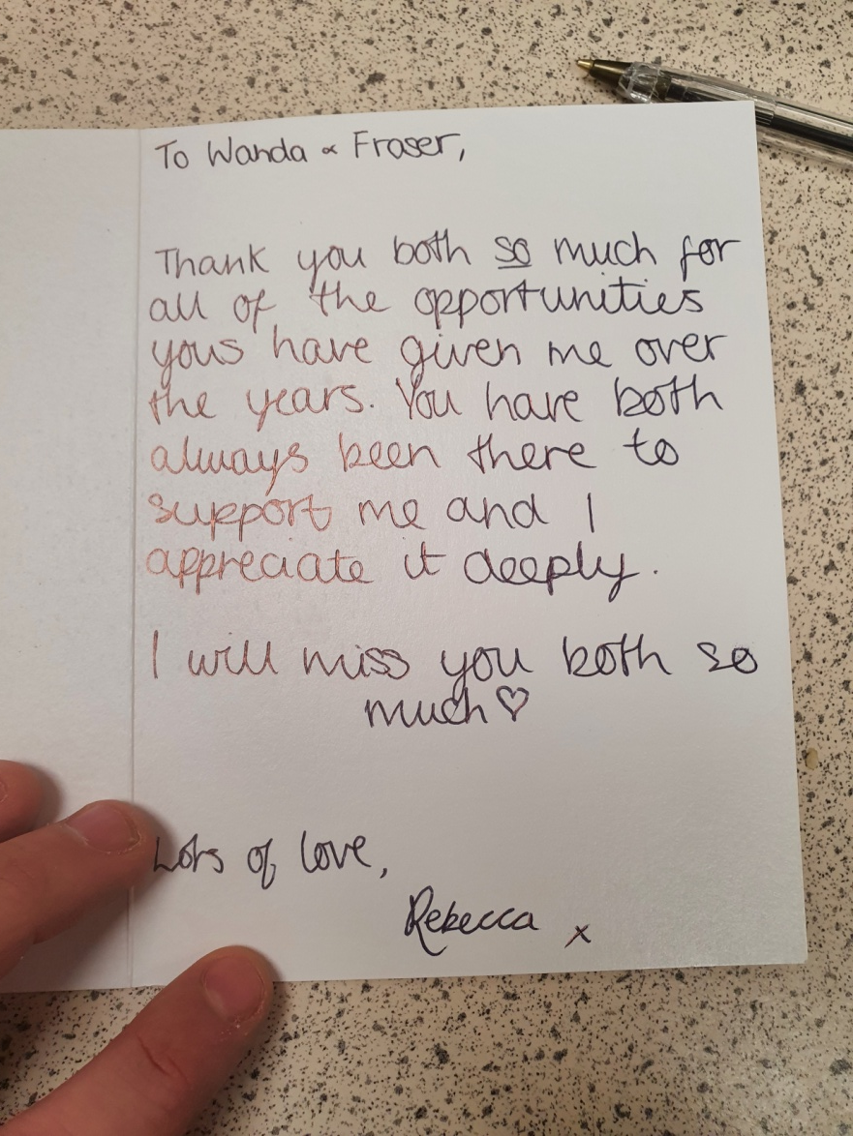
Appreciation from Young People who are leaving

